Slide 1

HOUSING PRICE PREDICTION
Submitted by:
Priyanka Yadav

Slide 2
Introduction
Houses are one of the necessary need of each and every person around the globe and therefore housing and real estate market is one of the markets which is one of the major contributors in the world’s economy. It is a very large market and there are various companies working in the domain. Data science comes as a very important tool to solve problems in the domain to help the companies increase their overall revenue, profits, improving their marketing strategies and focusing on changing trends in house sales and purchases. Predictive modelling, Market mix modelling, recommendation systems are some of the machine learning techniques used for achieving the business goals for housing companies. Our problem is related to one such housing company.
A US-based housing company named Surprise Housing has decided to enter the Australian market. The company uses data analytics to purchase houses at a price below their actual values and flip them at a higher price. For the same purpose, the company has collected a data set from the sale of houses in Australia.
By the means of this reports, I will be summarizing and explaining:
- Which variables are important to predict the price of variable?
- How do these variables describe the price of the house?

Slide 3
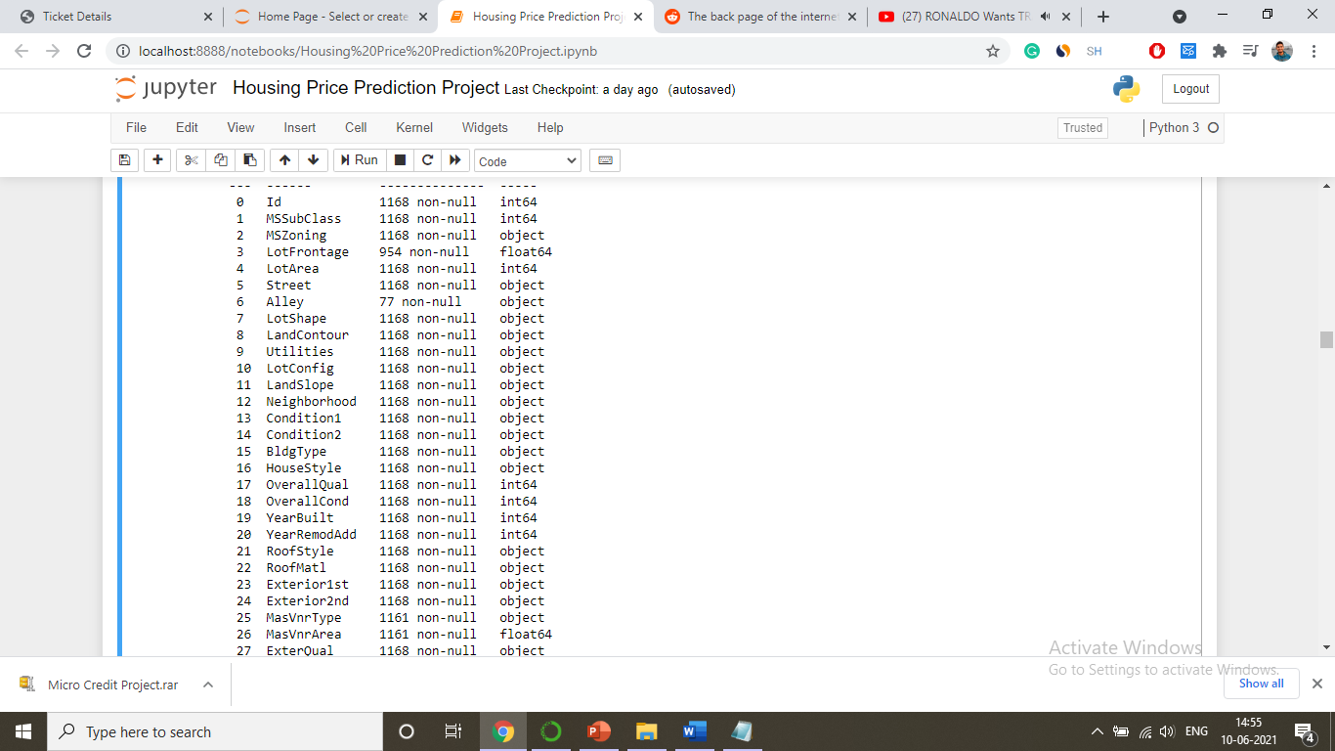
Dataset and Features
About the datasets
Data was been provided to me by FlipRobo Technologies. Whereas data belongs to a imaginary real estate company Surprise Housing. The data contains 81 columns and 1168 entries.
Features

Slide 4
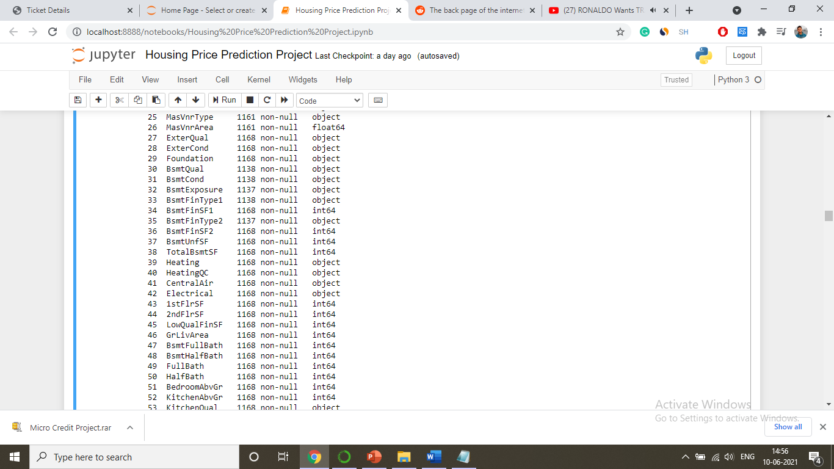

Slide 5
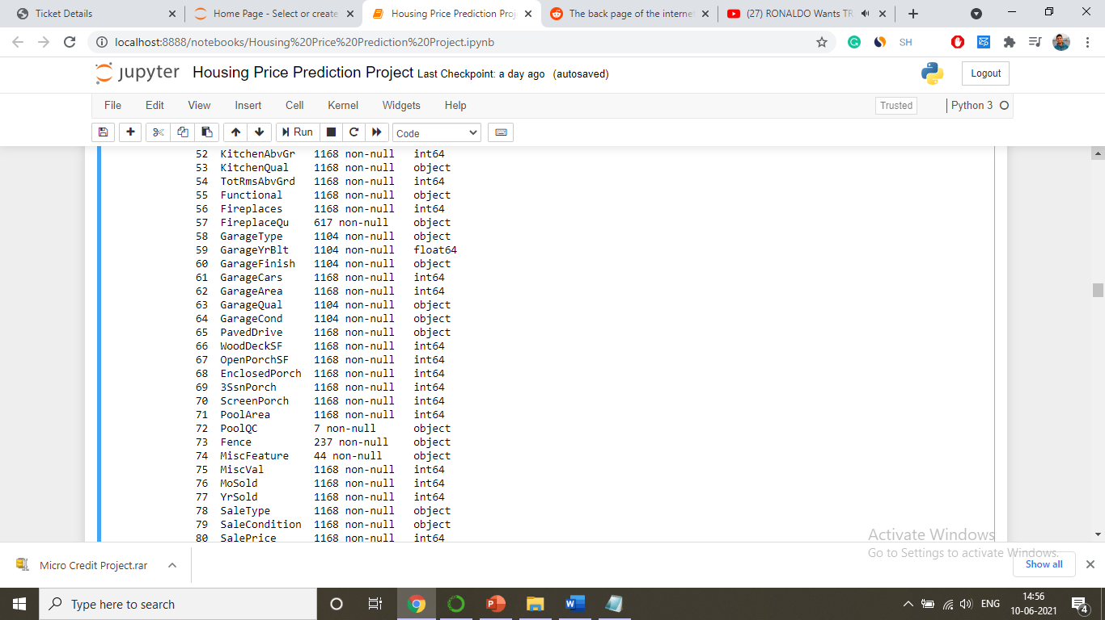

Slide 6
Data Pre-Processing & Cleansing
For keeping the only the useful data we used feature engineering. We removed the data if unnecessary by qualifying them on certain conditions like their uniqueness, their correlation with target variable and the no of outliers present in that particular variable.
We then tried the change the data into the form they belong to either by changing their type or by bifurcating the complex variables.
We also tried to treat the outliers and skewness present in the data.
We also scaled the data so that the data is standardized.

Slide 7
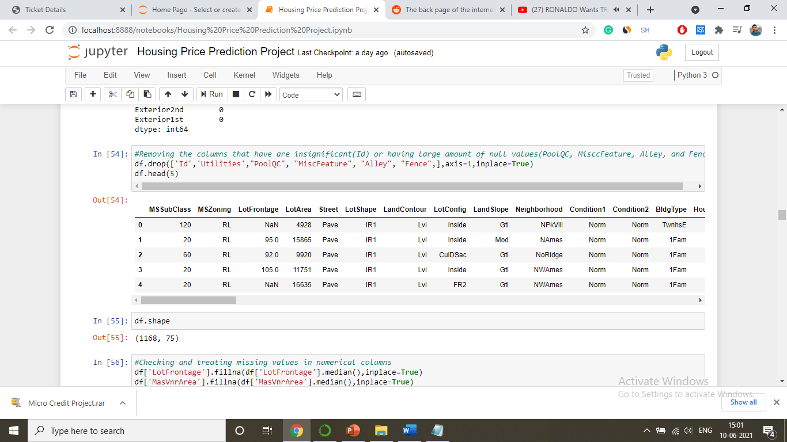
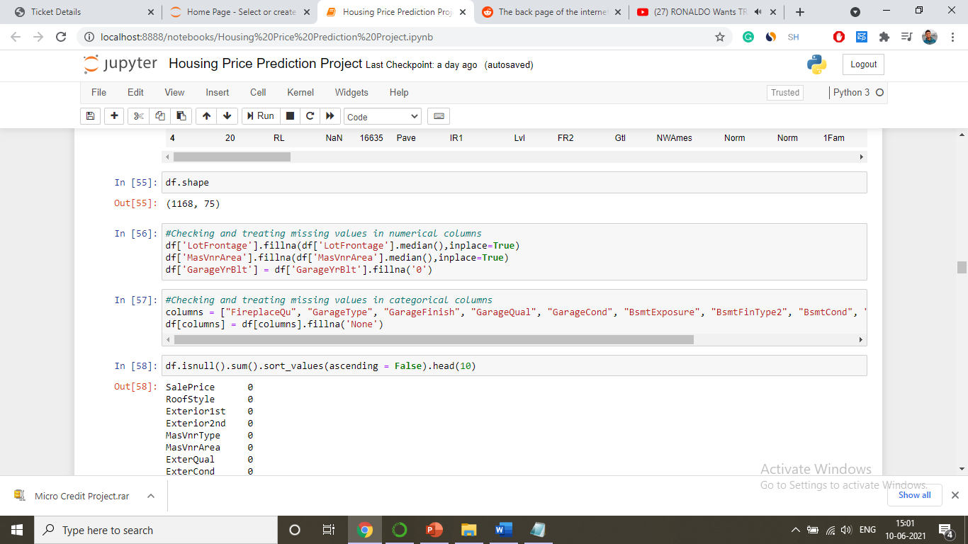
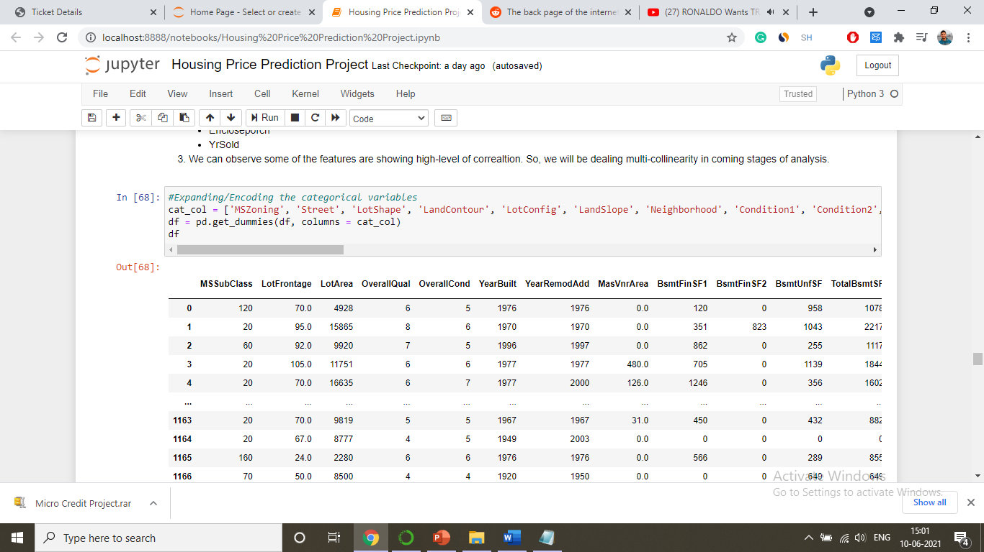

Slide 8
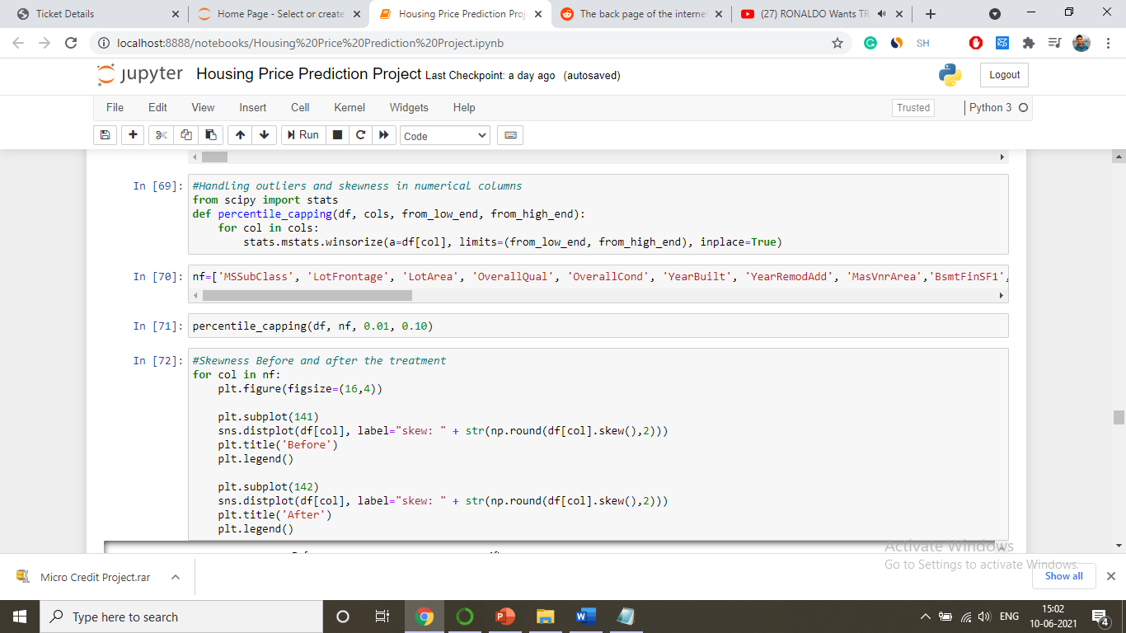

Slide 9
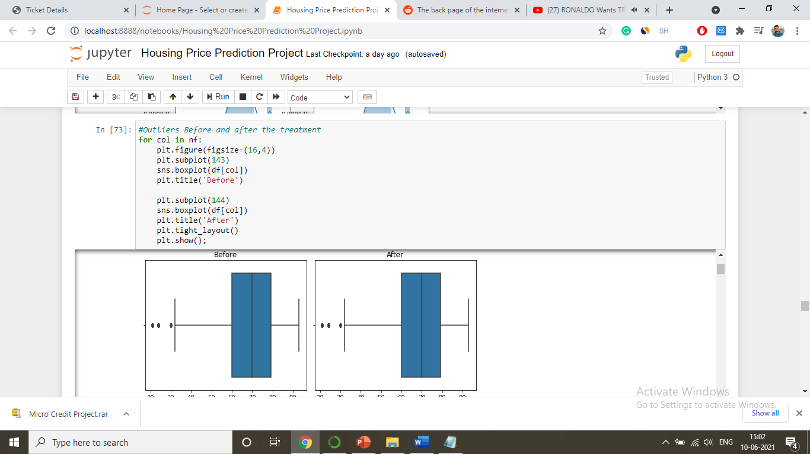
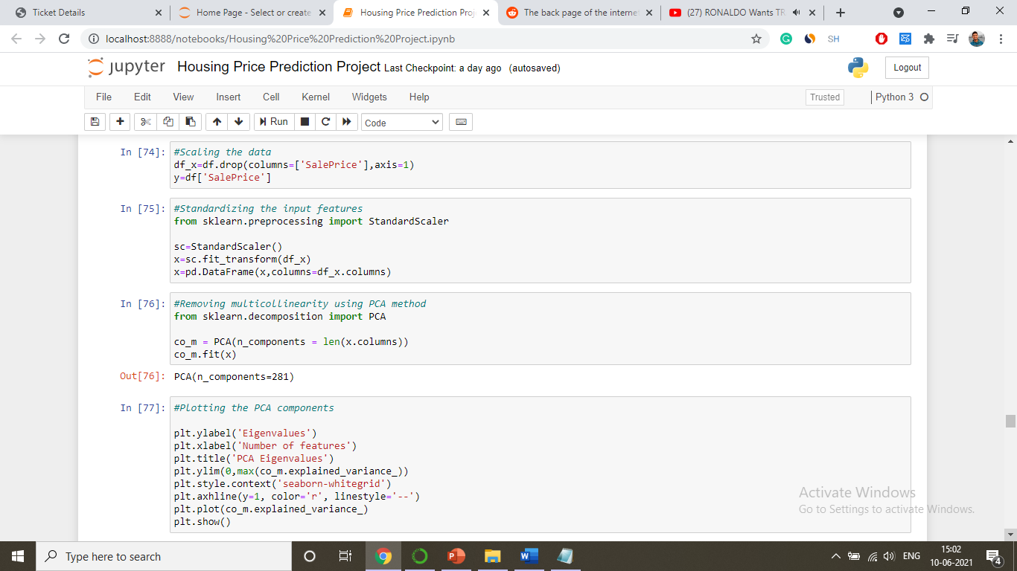

Slide 10
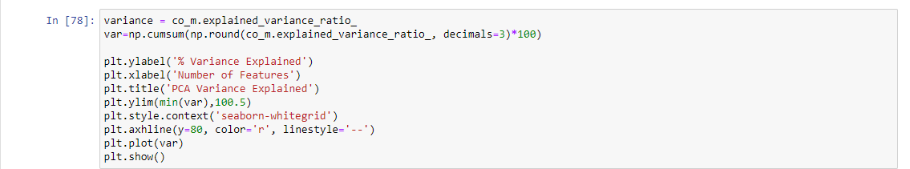

Slide 11
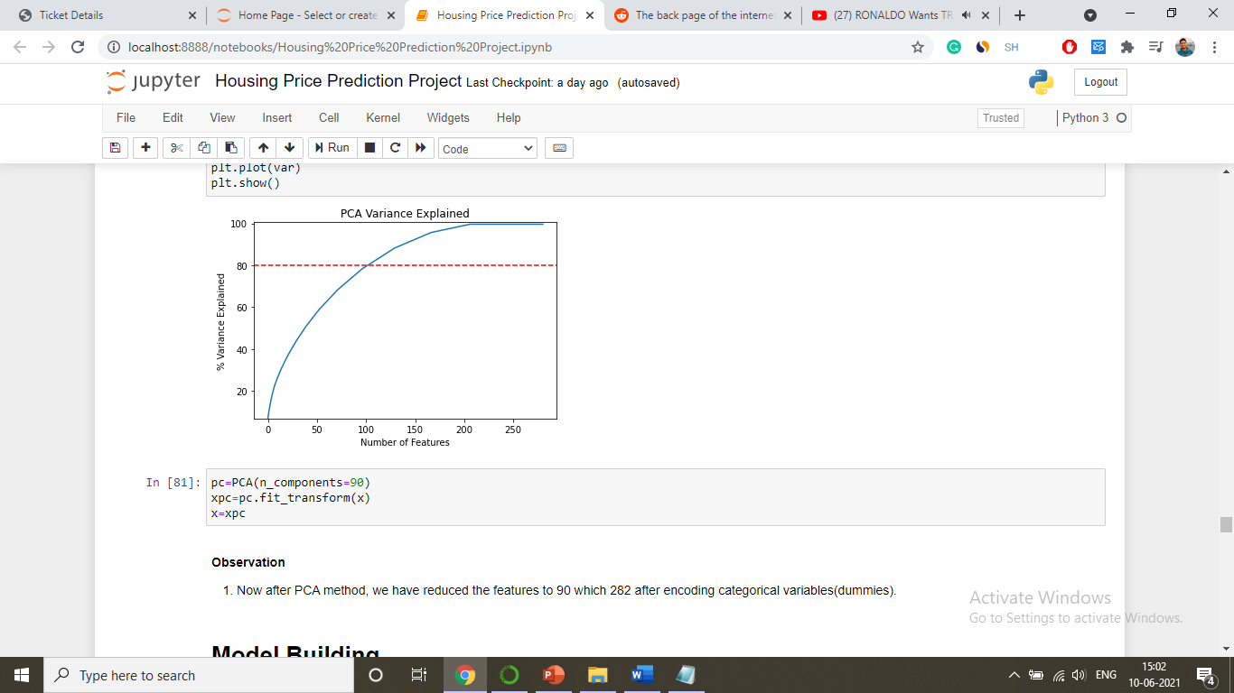

Slide 12
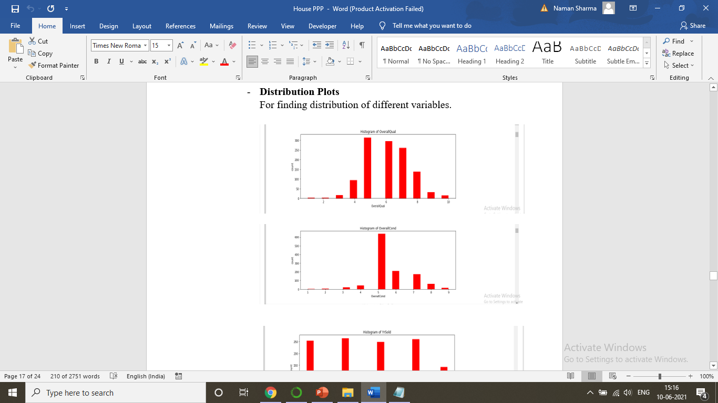
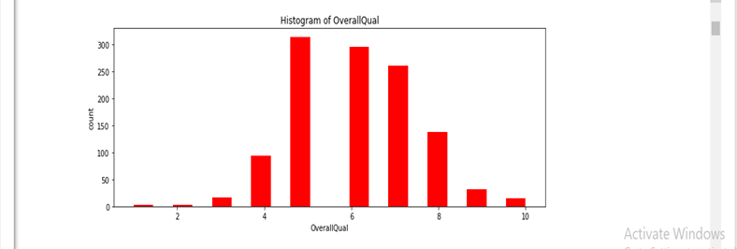
Data Analysis & Visualization

Slide 13
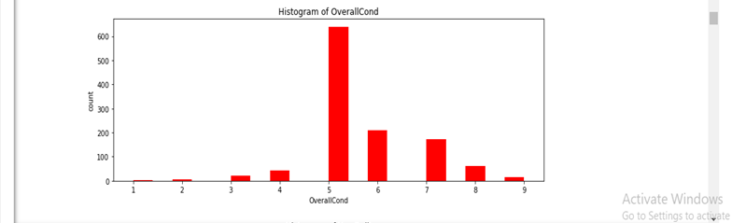
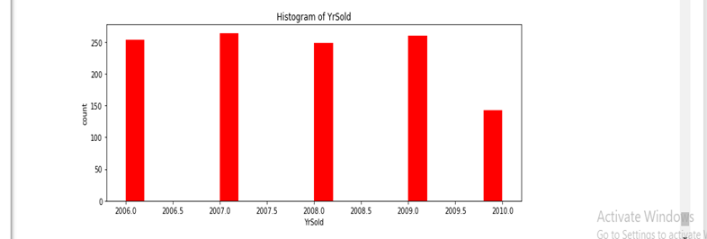

Slide 14
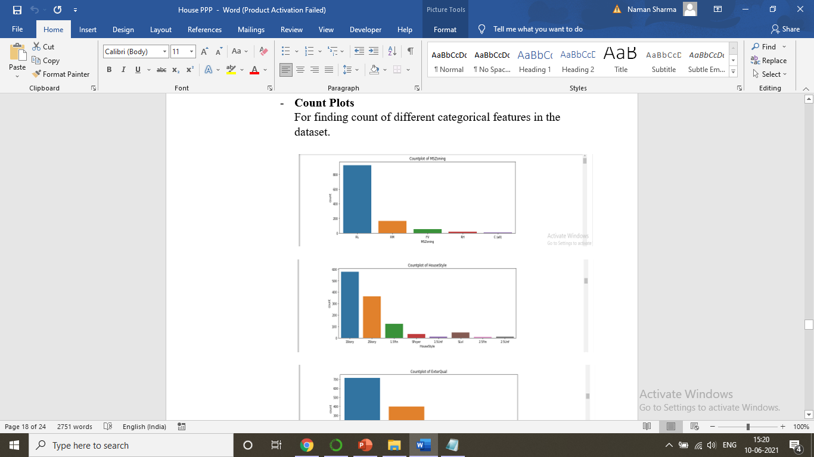
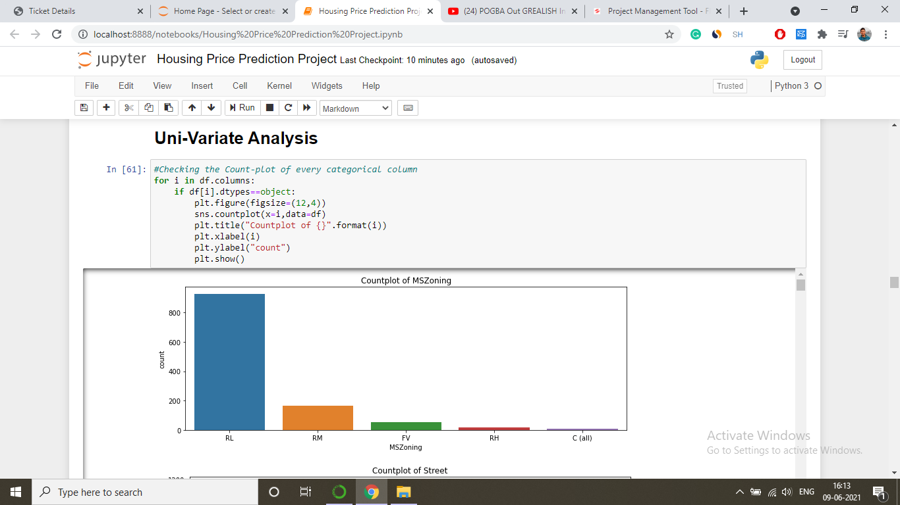
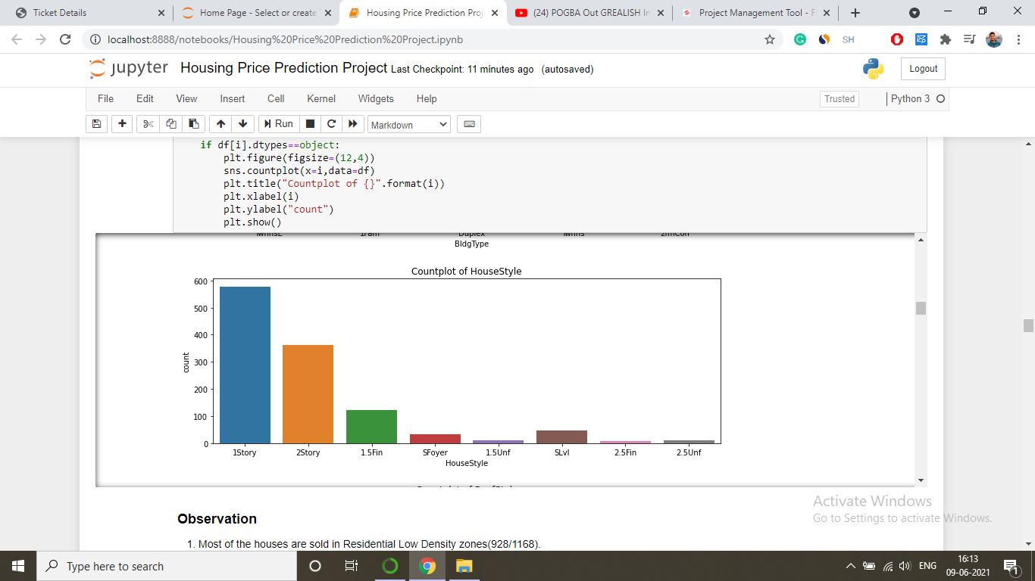

Slide 15
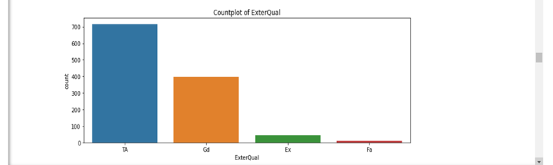
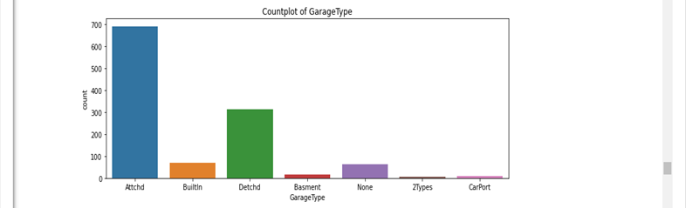

Slide 16
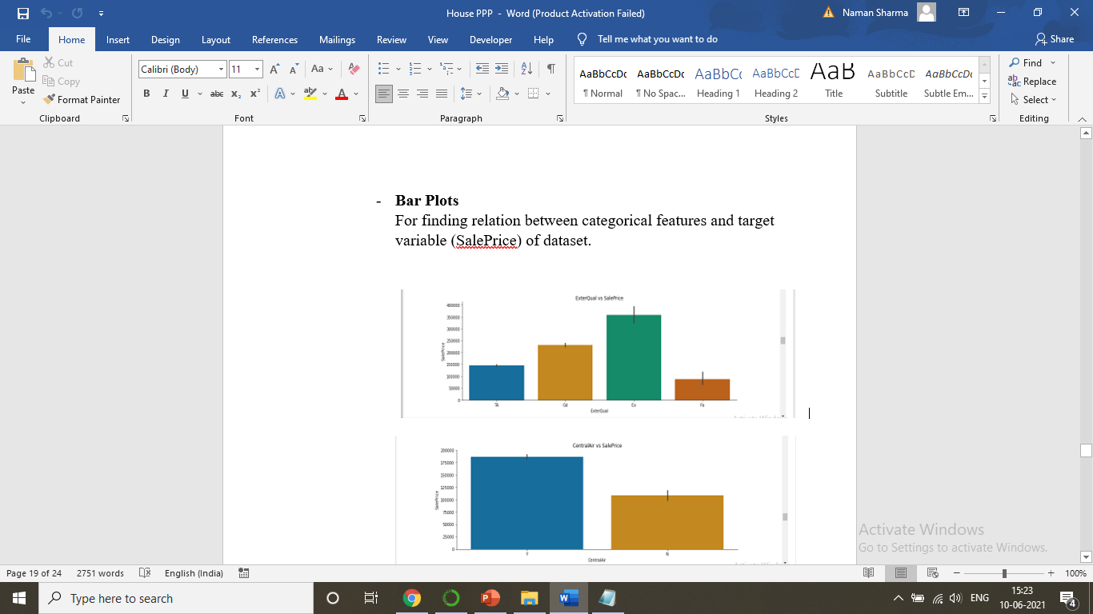

Slide 18
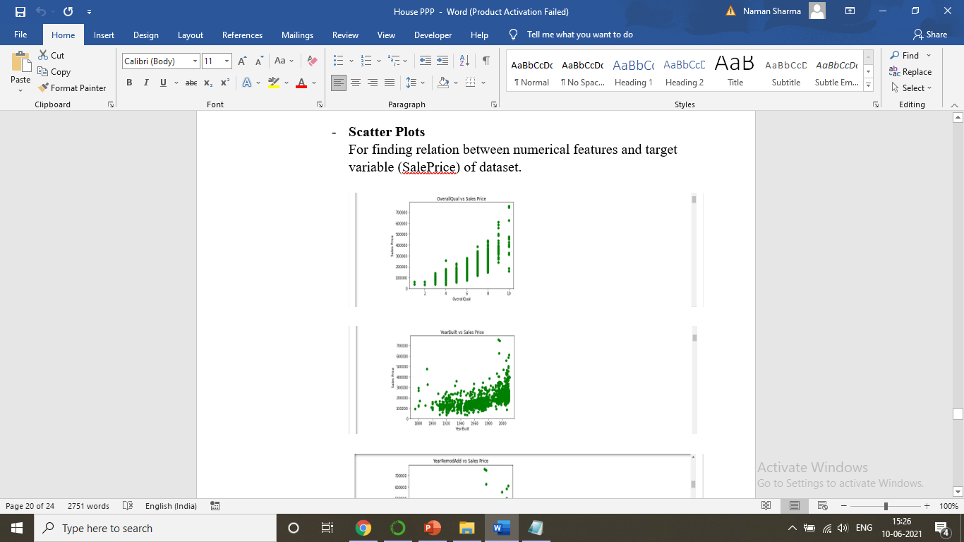
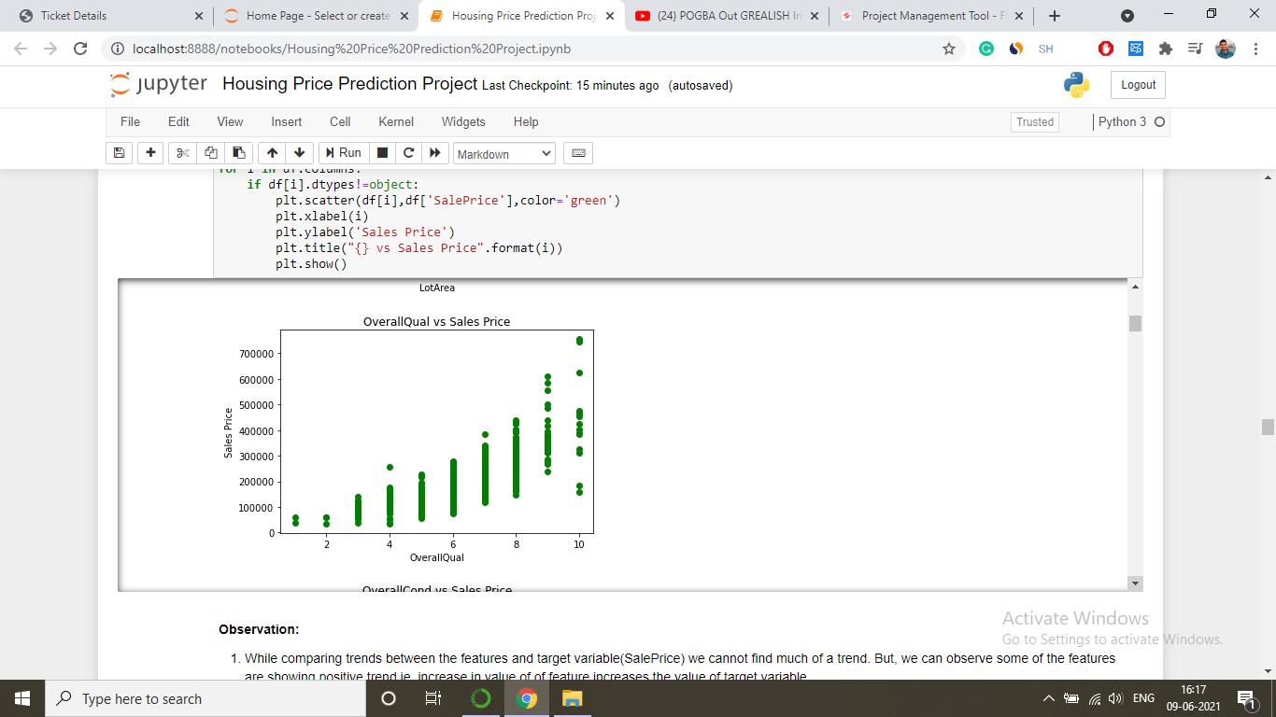
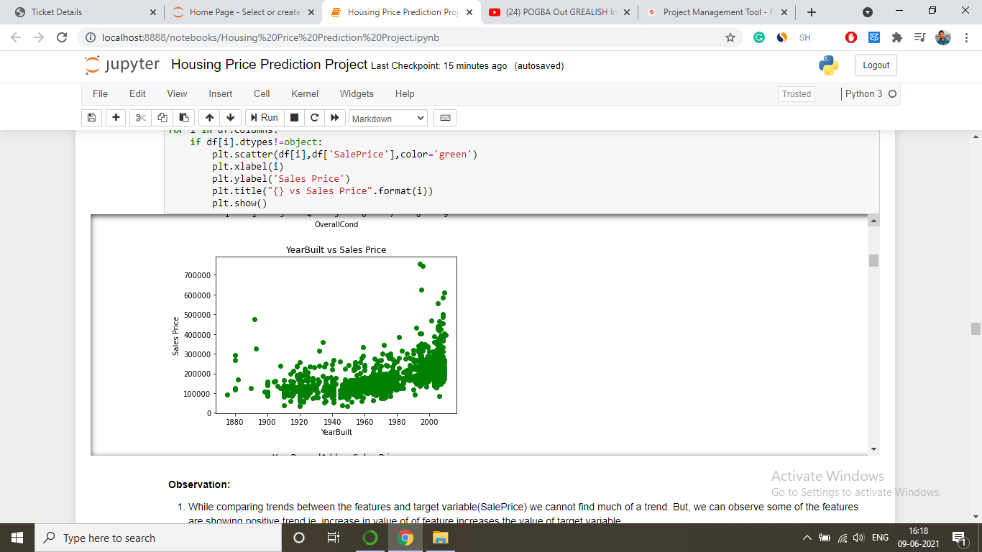
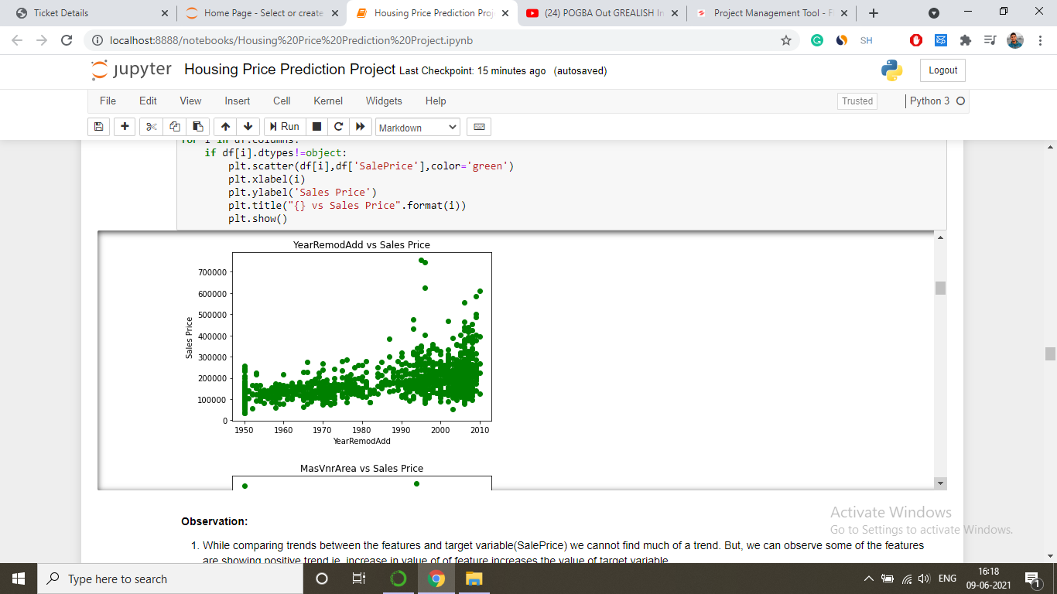

Slide 19
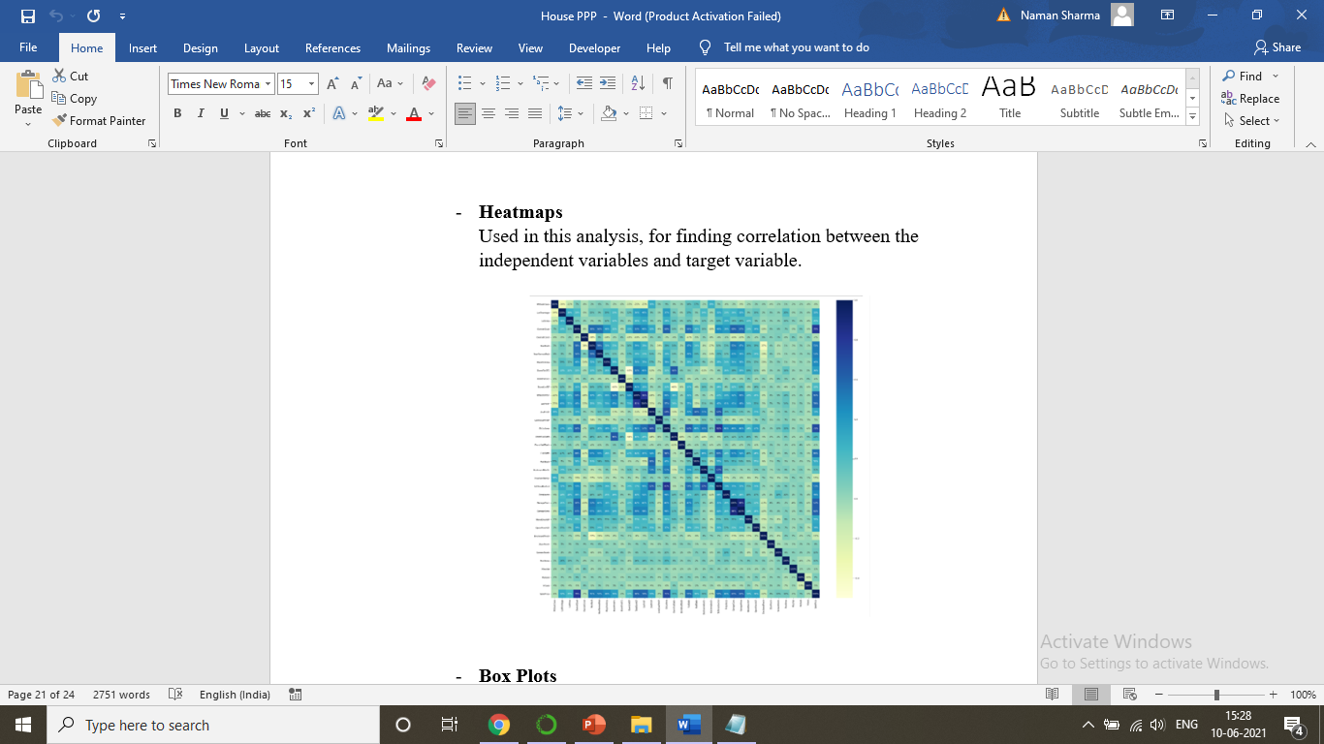

Slide 20
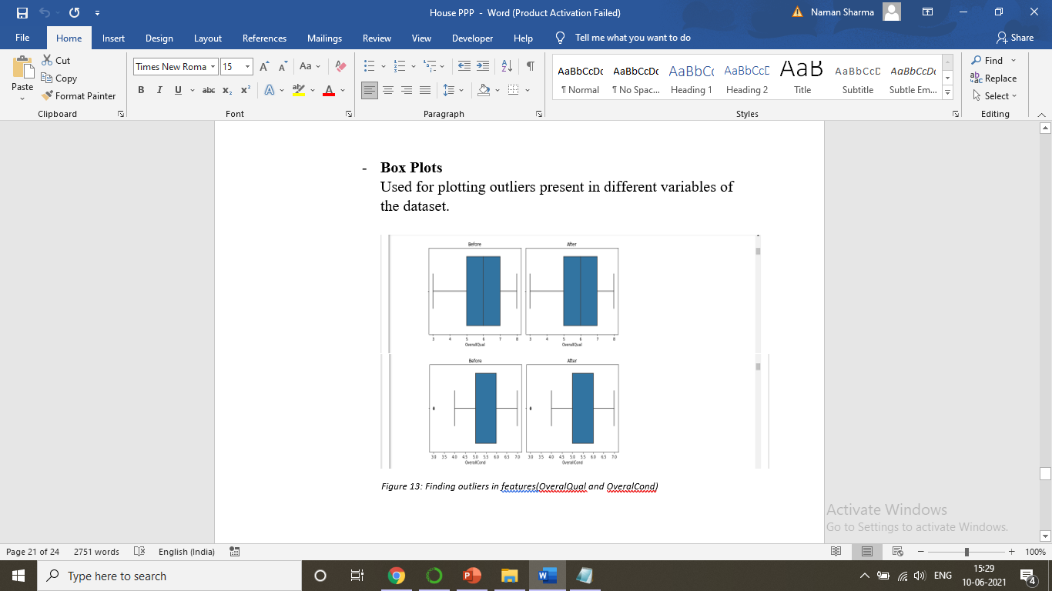

Slide 21
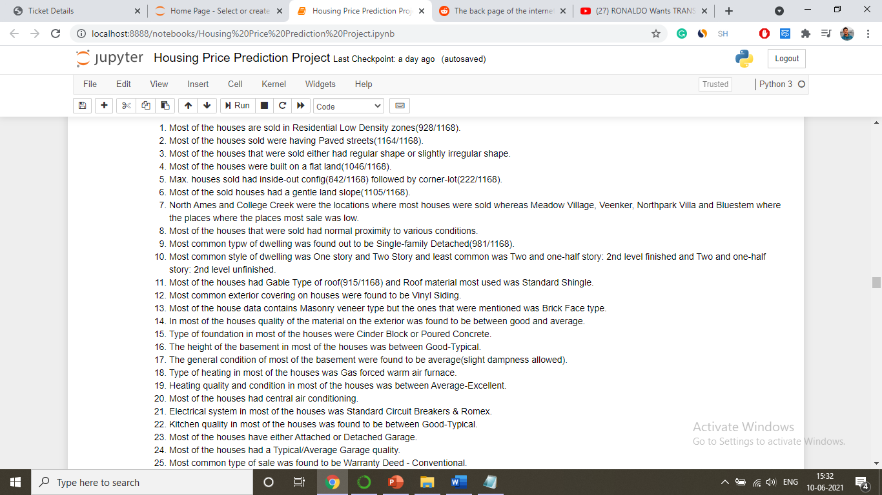
Findings from EDA

Slide 22
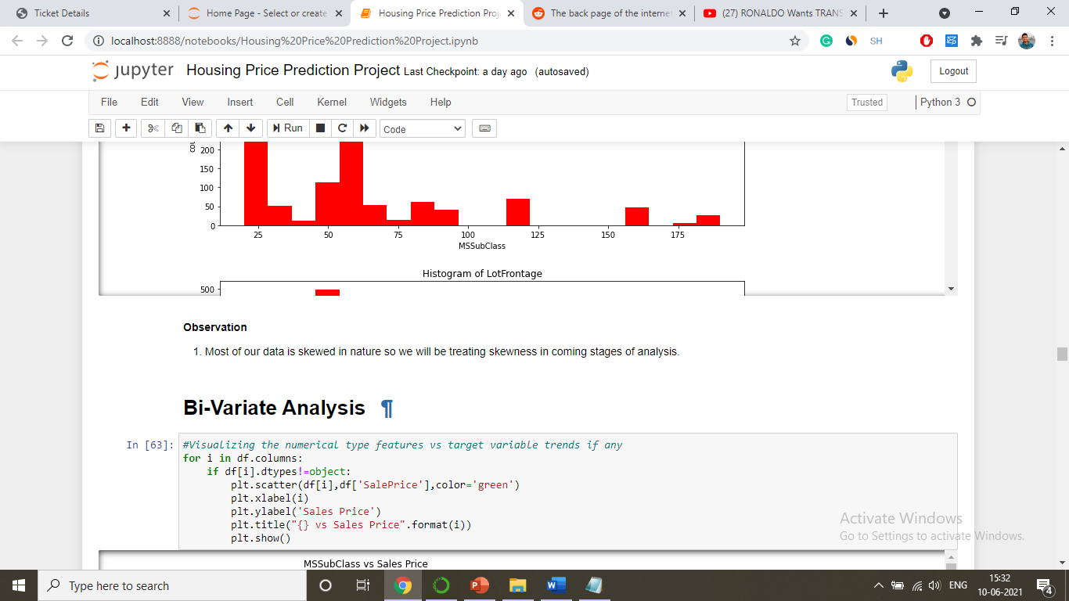
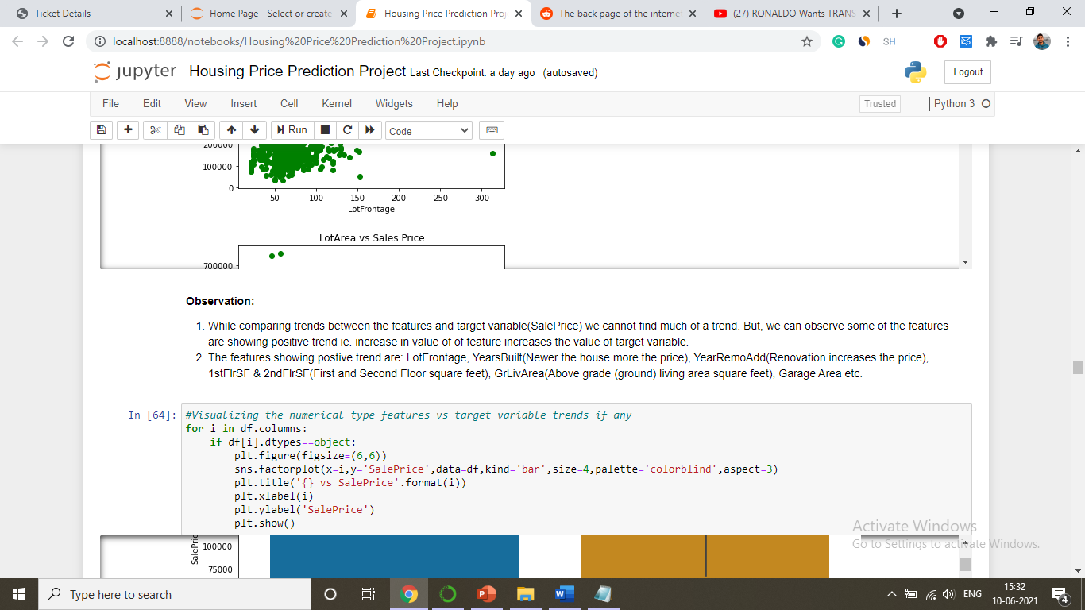

Slide 23
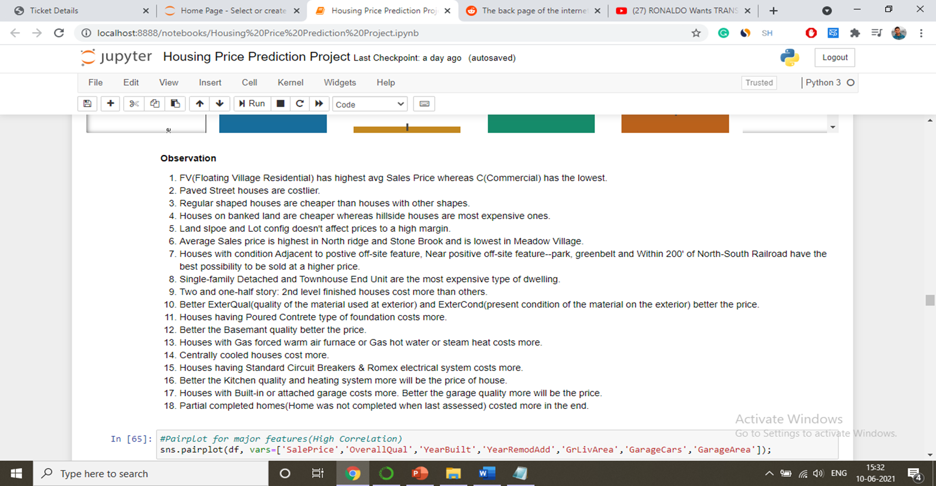

Slide 24
Correlations

Slide 26
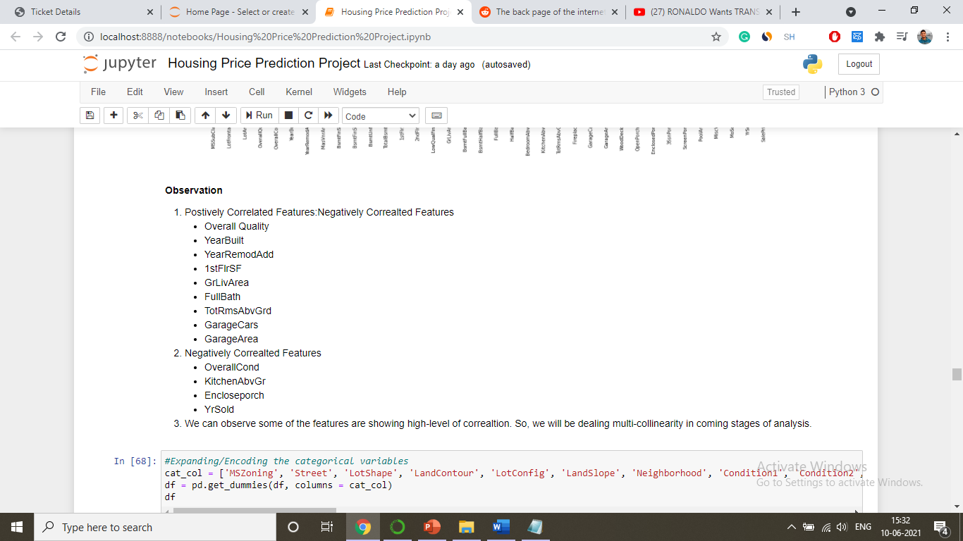

Slide 27
Plotting Outliers

Slide 29
Model Pre-Proecessing

Slide 30
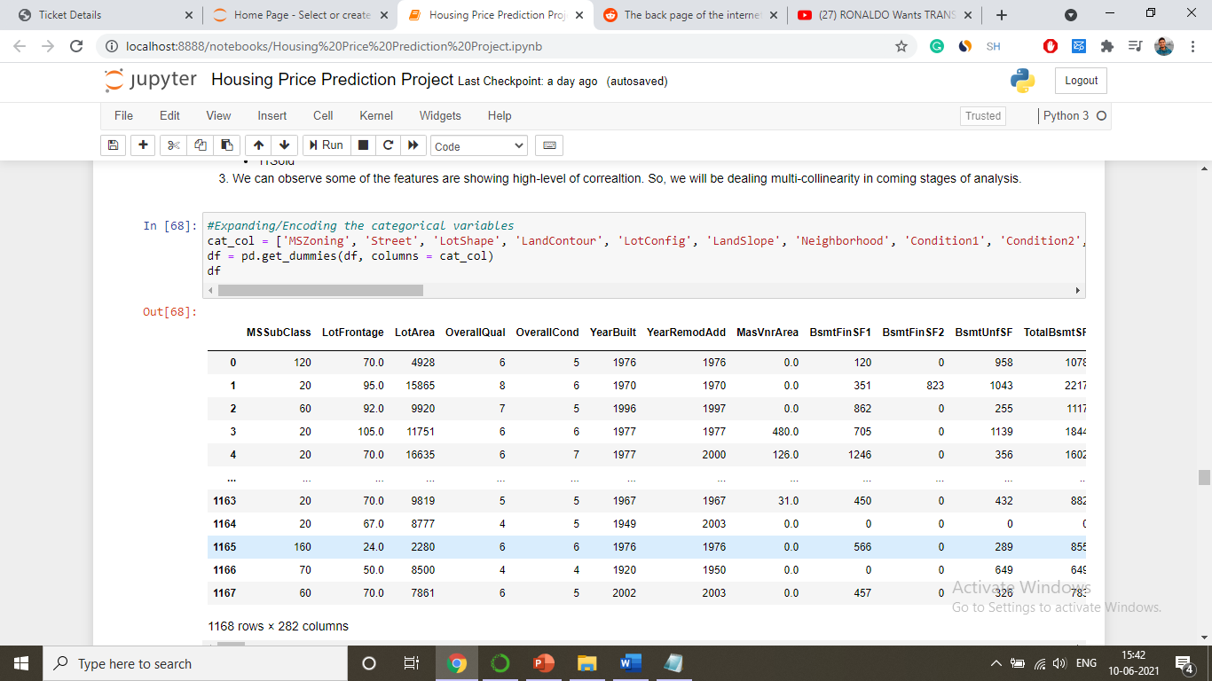

Slide 31
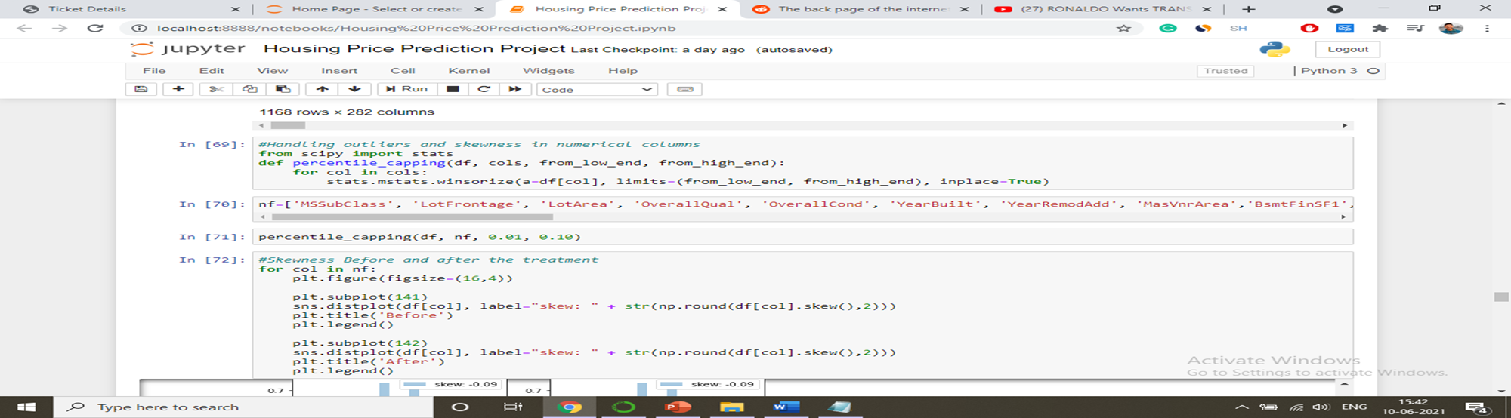

Slide 32
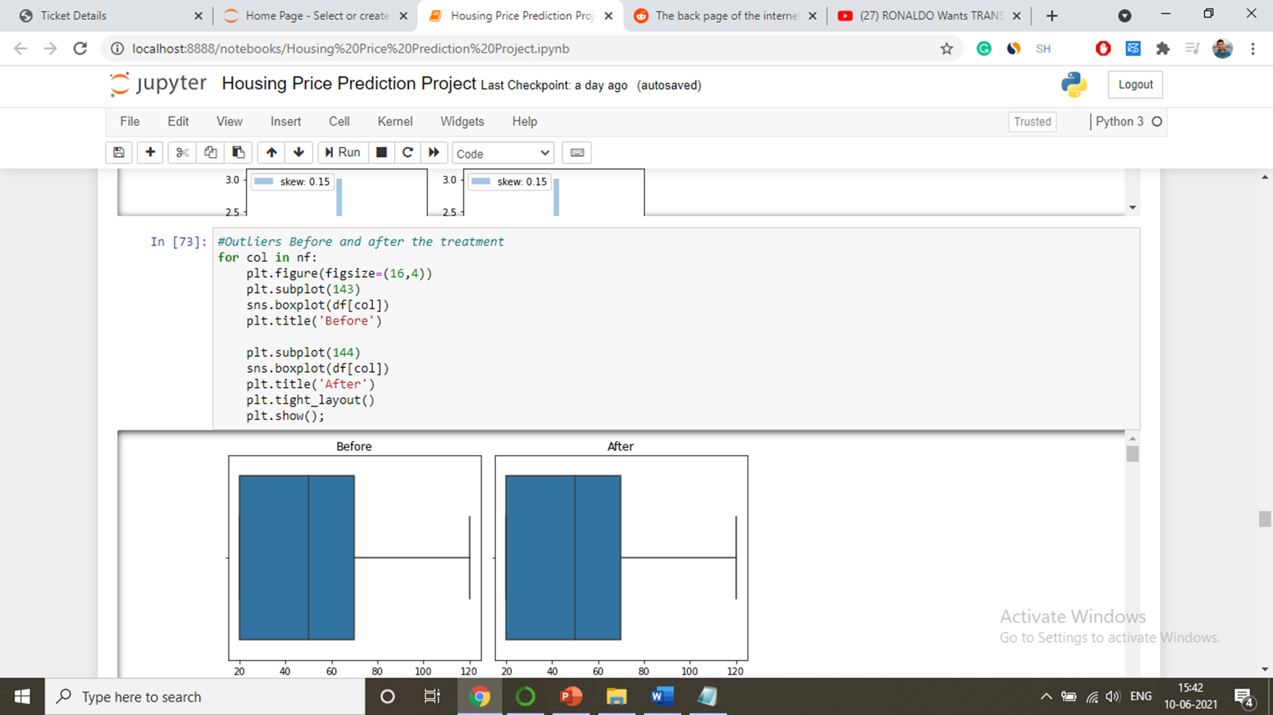

Slide 33
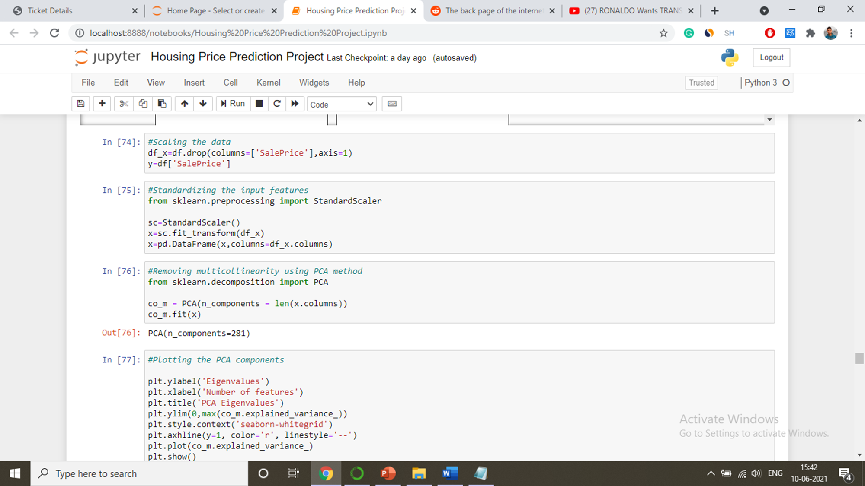

Slide 34
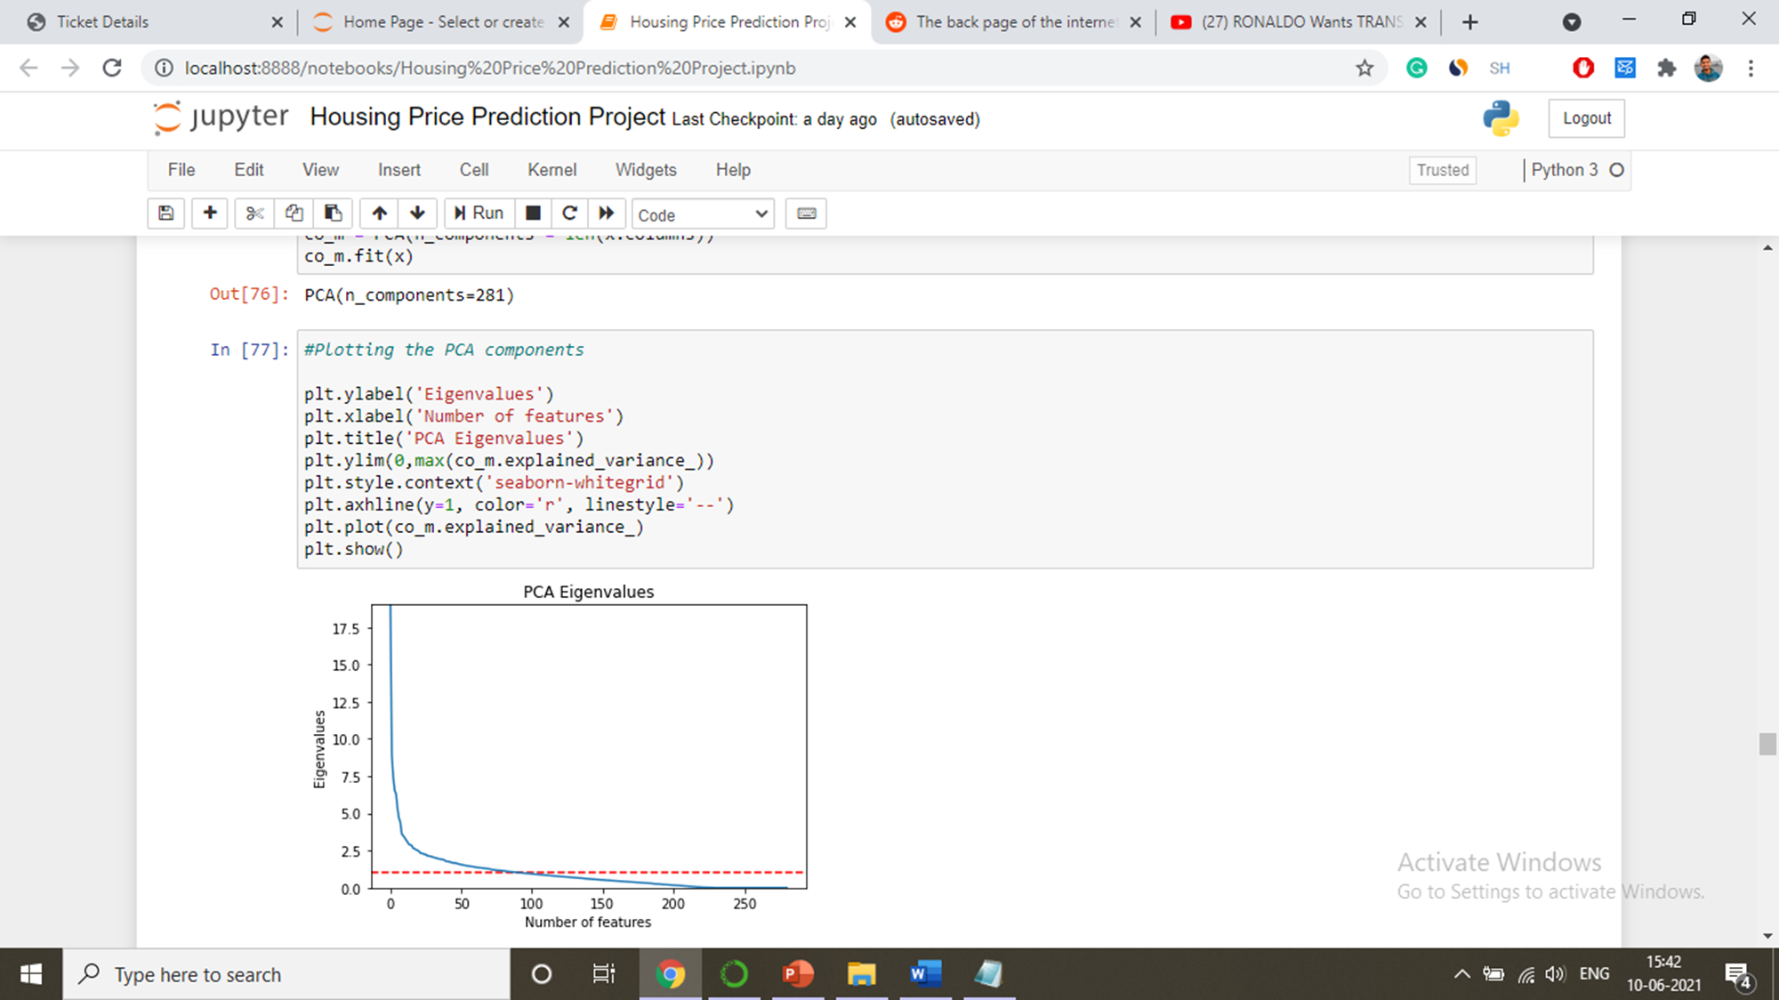

Slide 35
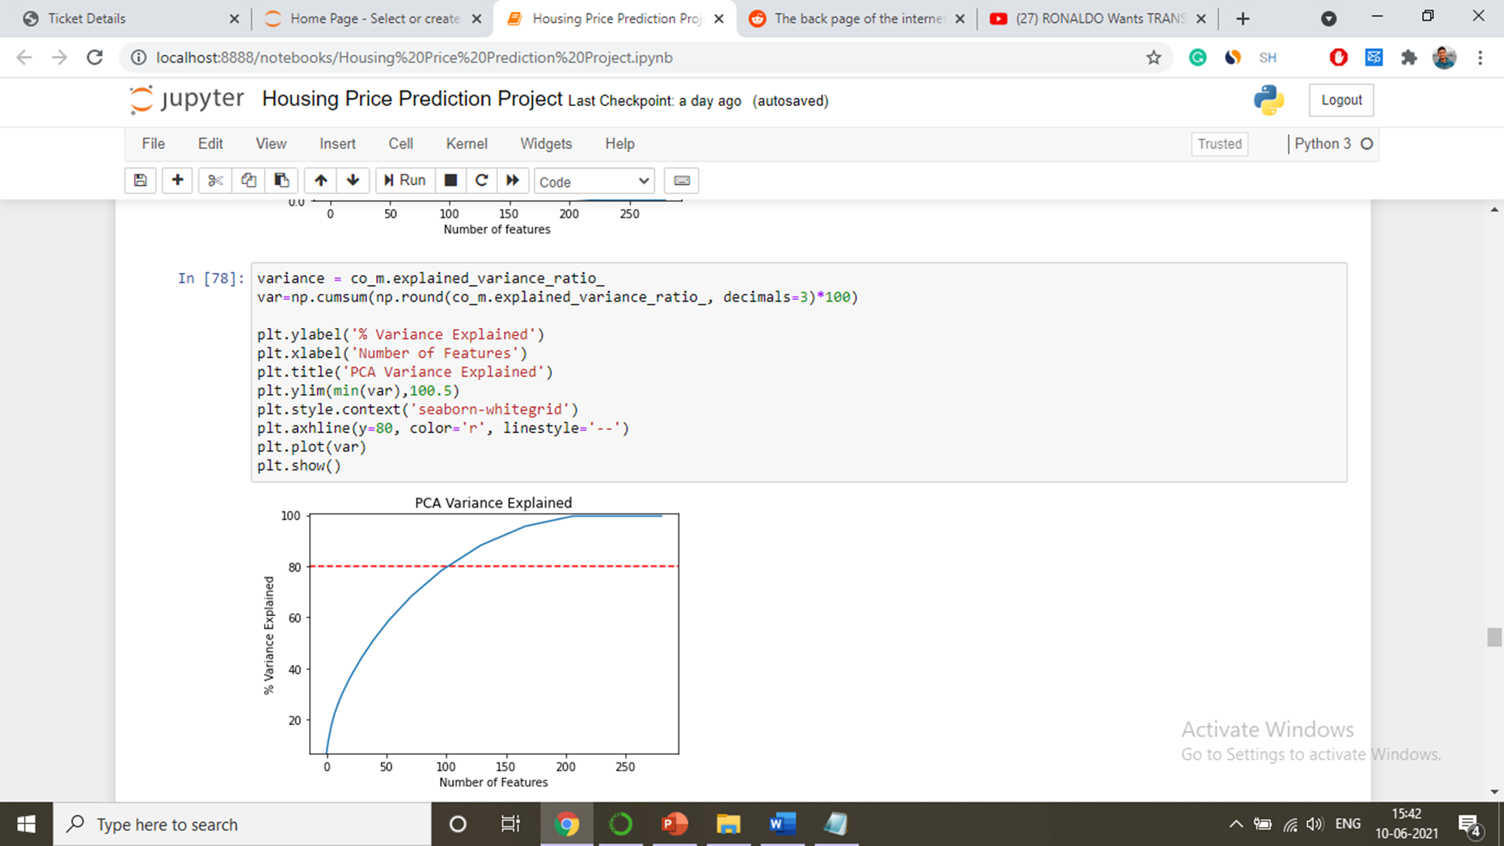
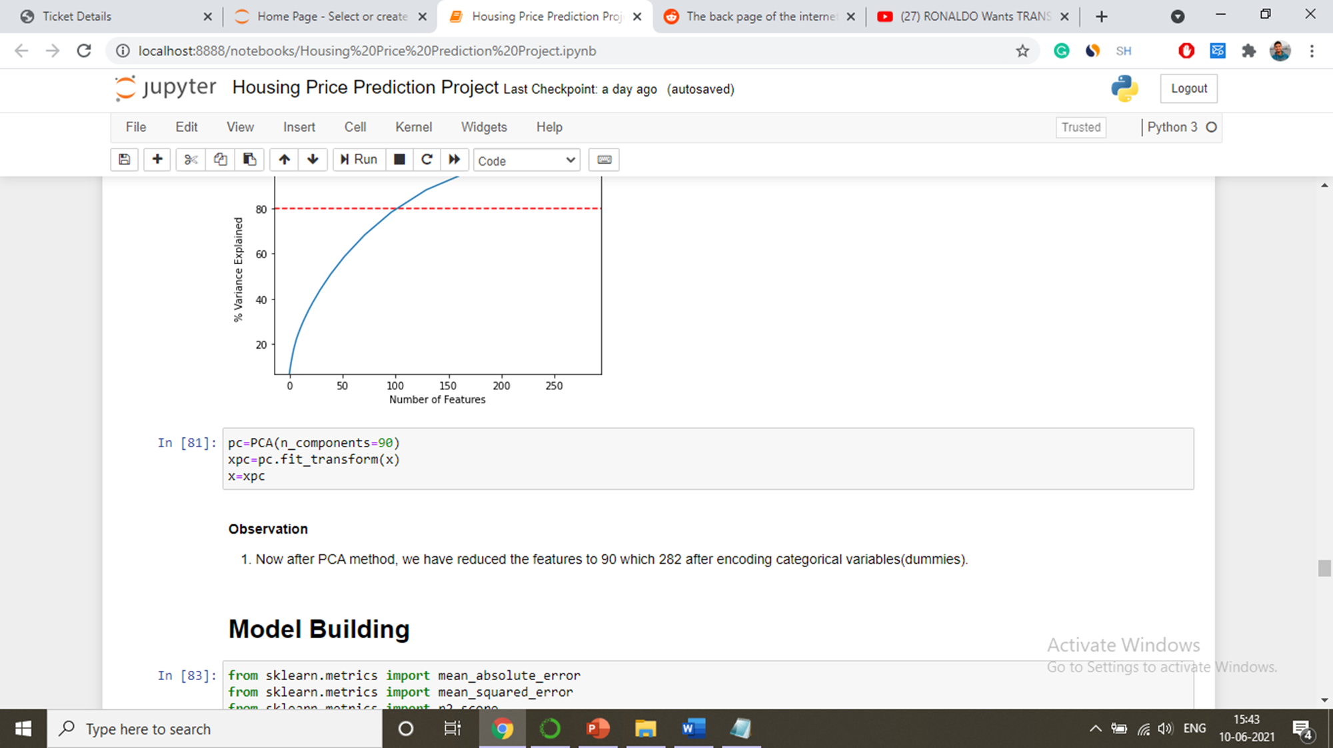

Slide 36
Model Building, Development and Evaluation

Slide 37
In this analysis, we have used multiple algorithms and three ensemble techniques to boost the predictive scores for better results. With the help of this approach, we will be able to successfully predict price of houses.
ALGORITHM USED:
Linear Regression - L1(Lasso), L2(Ridge) & ElasticNet Regressor
Decision Tree Regressor
K-Neighbour Regressor
ENSEMBLE TECHNIQUE USED:
Gradient Boosting Regressor
AdaBoost Regressor
Random Forest Regressor
We ran these algorithms in order to find best fitting model and best accuracy and other different parameters.

Slide 38
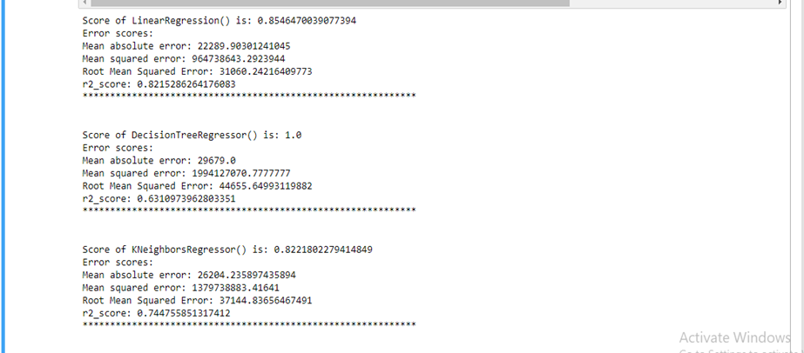
Scores and Errors for Different Models

Slide 39
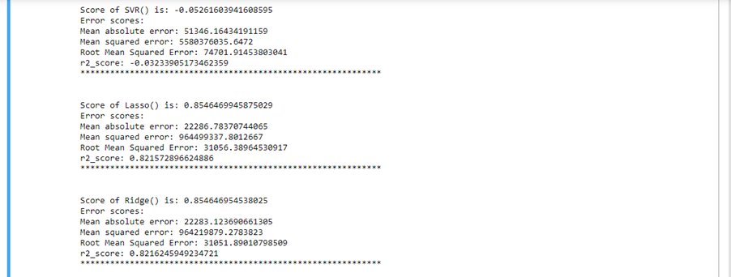
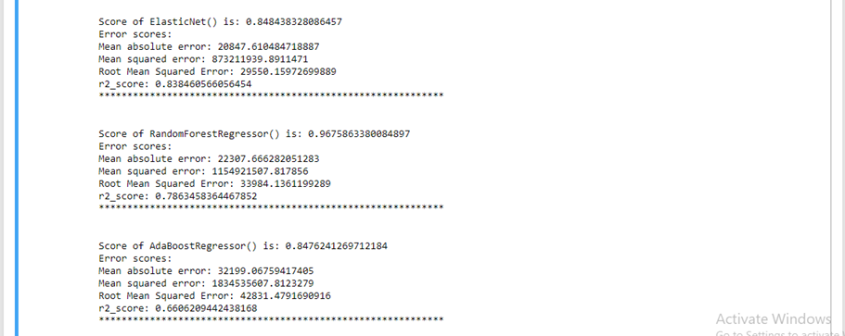

Slide 40
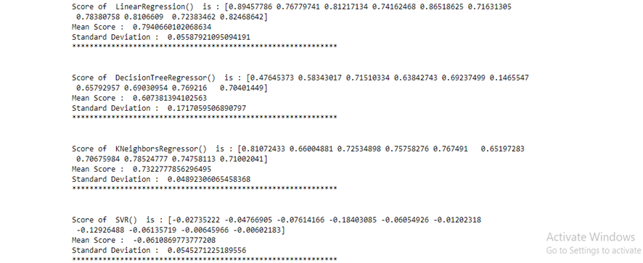
Cross Validation Scores for Models

Slide 41
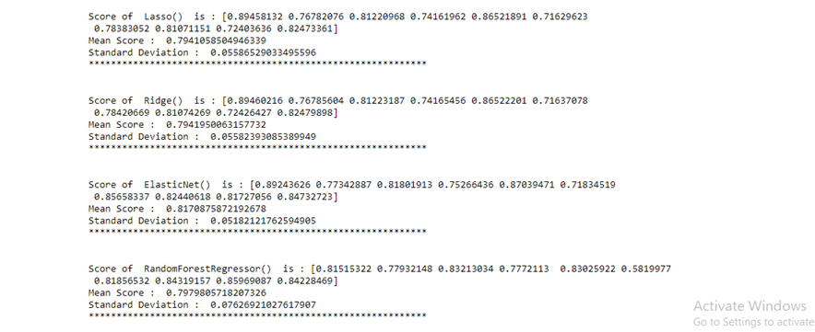
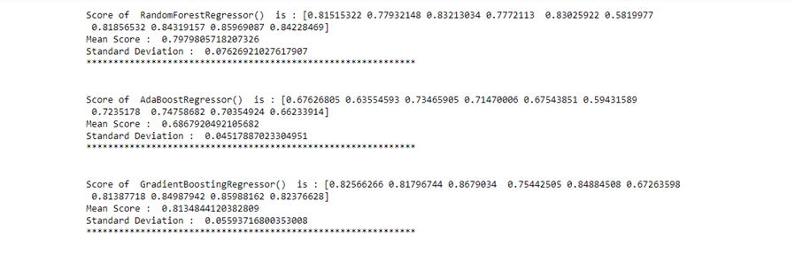

Slide 42
Summary Of Result of Best-fitted Model

Slide 43
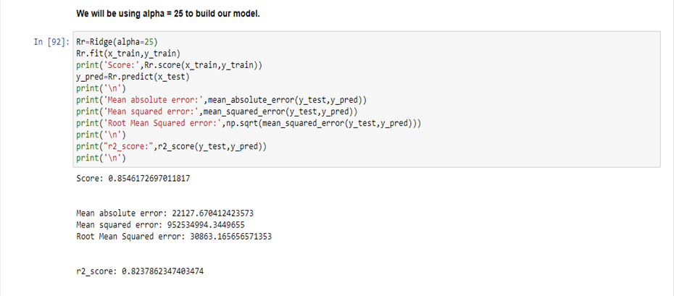

Slide 44
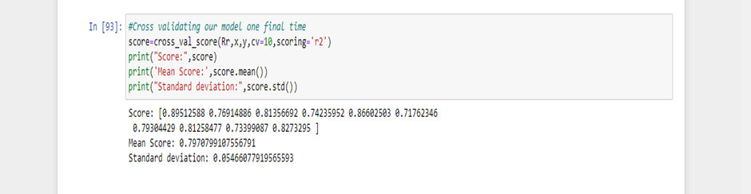

Slide 45
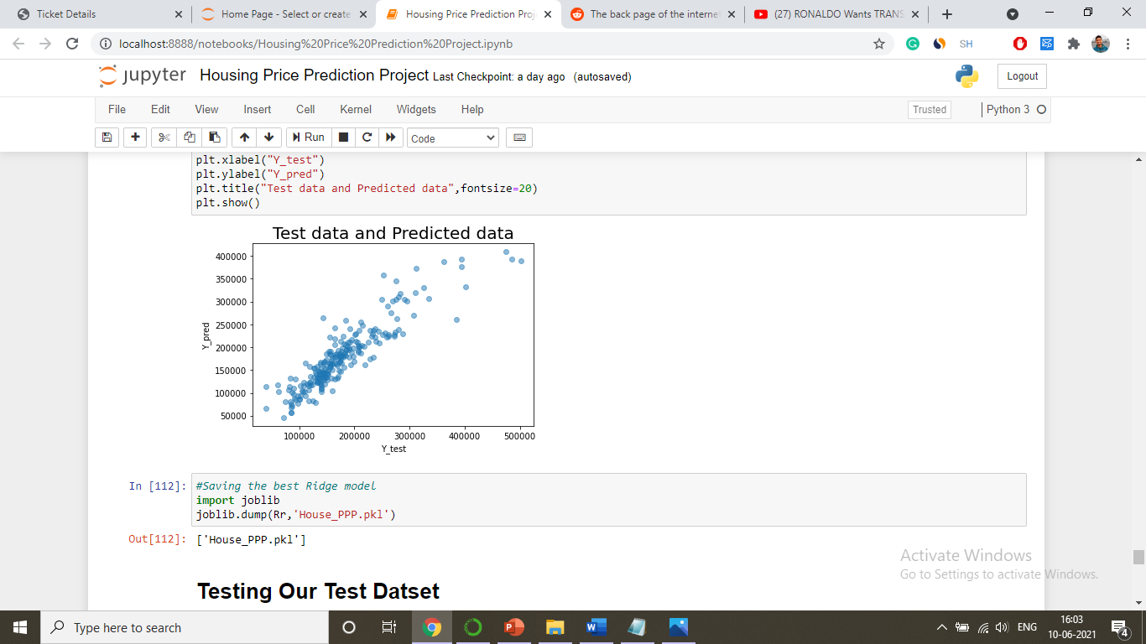

Slide 46
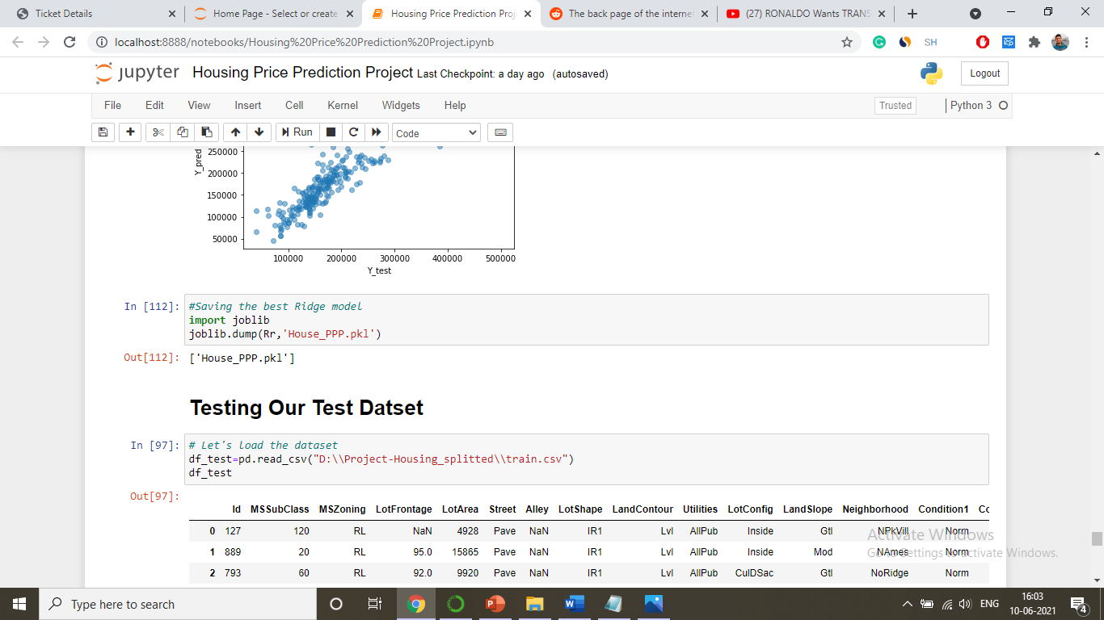
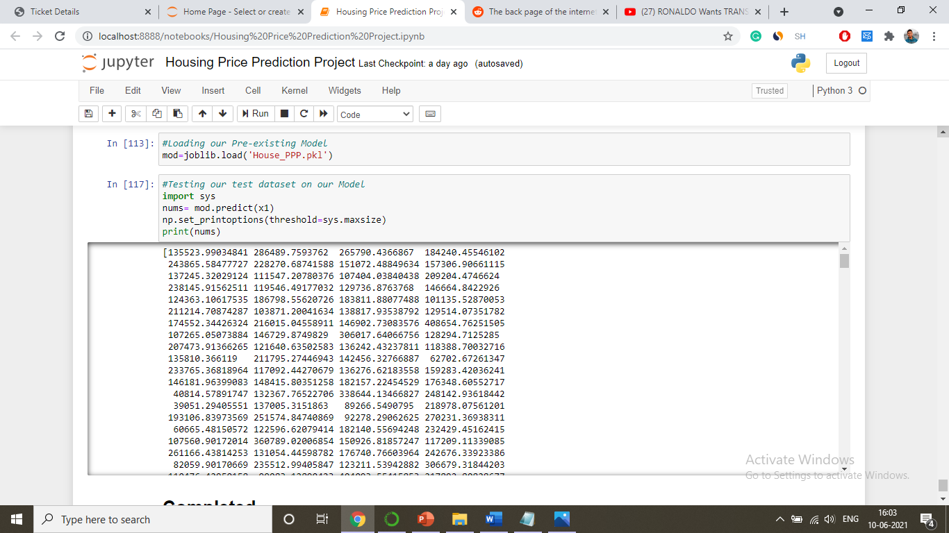
Saving The Model and then Loading it for future use

